Slide 1
QUAR ON TIME
BY
DEVI G
PAVITHRA G
PRASANNA M

Slide 2
Introduction
Corona virus disease (COVID-19) is an infectious disease caused by a newly discovered corona virus.
People who came in contact with infected patients are placed in self quarantine
Our application helps people in self quarantine to buy essential items without leaving from home
It helps them to order items from nearby stores where the item is in stock so they do not have to visit multiple stores
This application can be used in future by anyone who is not able to go to the store for buying any items.

Slide 3
Objectives
Home isolate people can get their essential needs without others guide and assistance.
This online shopping will give a new experience and refreshment to isolates.
The risk of spreading the infection is reduced as the person is not going out of the home
Easily can get the emergency items.
Easily access able.

Slide 4
STRUCTURE AND DESIGN

Slide 5
APPLICATION DESIGN
In this pandemic situation whoever is ready to serve the society, can register as a volunteer here.
Home isolates can also register to the application to order their essentials.
All shops also can get in touch with us to register and upload the inventory.
This website can be accessed from either a PC or mobile device.
Users can order items from the store and view their total amounts
Volunteers can view which items they need to deliver

Slide 6
SITE MAP
The following site map is proposed. This site map may change during the development of the website.
Home Page – including an introduction , contact details of phone , address, fax, and email
About us Page - including an details about our service
Volunteer - including an sign in & sign up form of volunteers
Patient – including an sign in page for home isolates
Shop – This page will contain the details of shop coordinating with us.

Slide 7
DESIGN PROCESS
PHASES TO WEBSITE DEVELOPMENT
ER Diagram
UI/UX
Mockups/Design
Back end coding
Front end coding
API connection
Testing
Hand over
Github Link: https://github.com/Deviganesan99/myproject

Slide 8







Software models

Slide 9
Demo

Slide 10
Conclusion
In this current situation of COVID-19 this system is useful for people who all are under home isolation.
They can get their essentials needs on a time and safely it is a main motto of our project.
This can also be used by elderly people who are not able to find any helpers
The application make the life easier and makes people to feel refreshed

Slide 11
Future enhancements
In order to improve and facilitate we can add Location map in future
Planning to covert our website as a mobile app also.
Now we are currently giving a services under Chennai location only plan to extend this service to other cities in TN.
In Future planning to setup donation page in our website.
Online payments will also be added

Slide 12
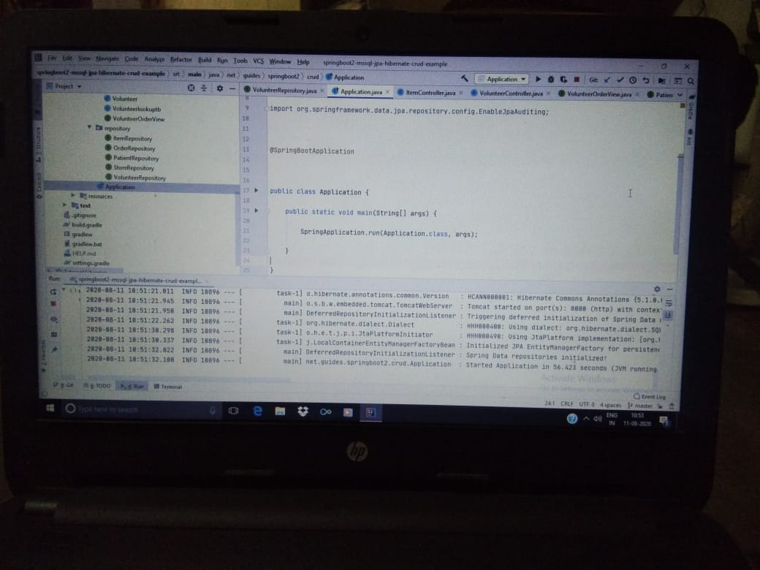
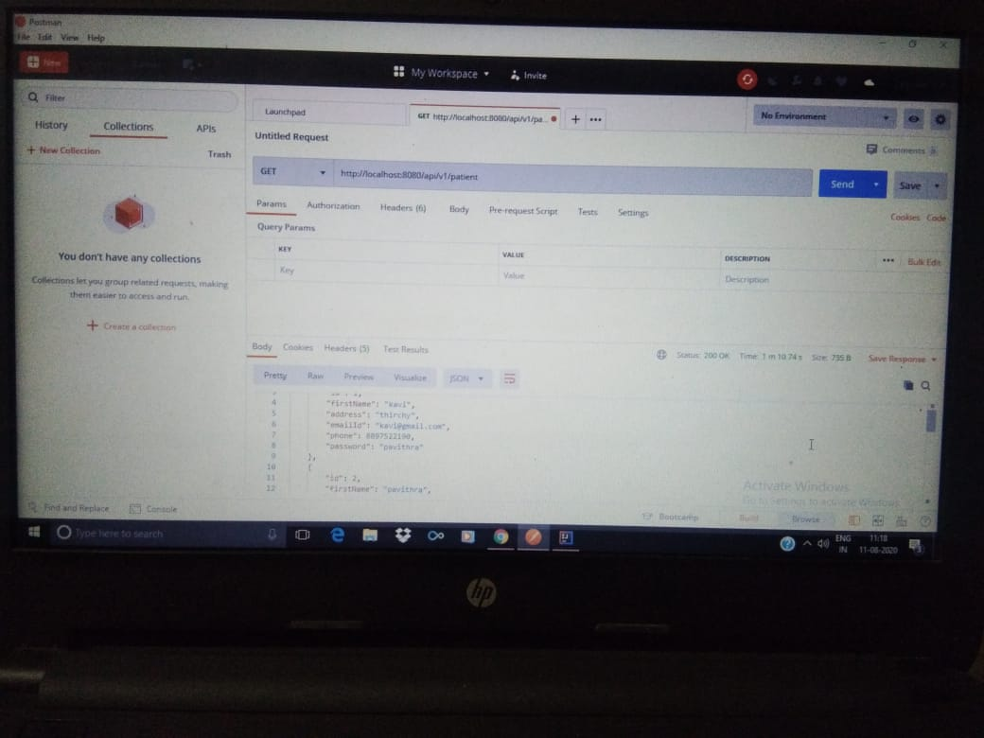
Results

Slide 13
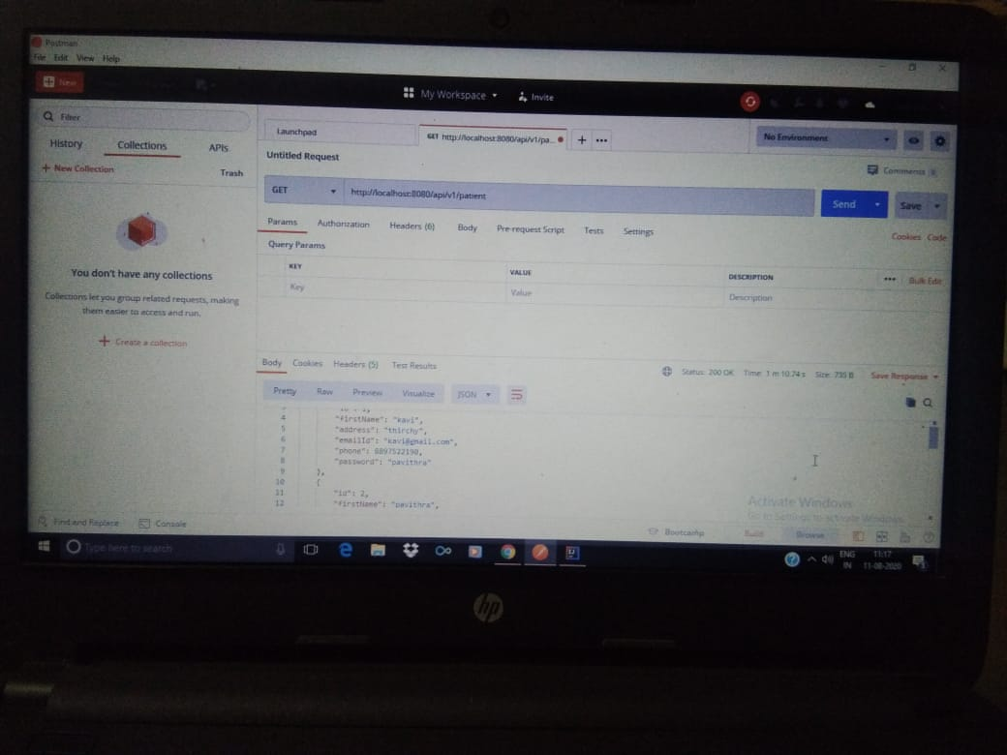
Results contd.,

Slide 14
THANK YOU

